Slide 1


Specialized Course: Demand Forecasting
Introduction to Time Series Analysis

Slide 2



Trainer’s Profile
Perkenalkan, saya
Barry Cavin
Now Learning Specialist Coordinator - Kemdikbud (GovTech Edu)
2020 Head of Content - Zenius Education
2018 School Principal - Erudio Indonesia
2017 Data Scientist - Tokopedia
2016 MSc Applied Mathematics - Imperial College London
2015 Data Scientist - Dattabot
2010 SSi Matematika Murni - Universitas Indonesia
www.linkedin.com/in/barrysianturi
barrys.sianturi@gmail.com
TMT Training
2022

Slide 3

Outline
01
Overview of Time Series Forecasting
02
Exploration and Understanding
03
Overview of Demand Forecasting Modelling Techniques
04
Model Evaluation
TMT Training
2022

Slide 4

Overview of
Time Series Forecasting
TMT Training
2022

Slide 5
What is Forecasting?
TMT Training
2022

Slide 6
Plant Capacity Requirements
Capital Expenditures
Personnel Requirements
What is Forecasting?
Customer
Demand
TMT Training
2022

Slide 7
Key Question:
What will customer demand be at some future point in time?
TMT Training
2022

Slide 8
Forecasting
Shorter time operational decisions
Longer time forecasts for strategic purposes
Any idea, how can we do this?
TMT Training
2022

Slide 9
Forecasting
Qualitative
Market Research
Interview
FGD
UAT
Survey
Executive Judgement
Historical Analogies
Quantitative
Causal Forecasting
Time Series Forecasting
Some ideas to predict customer demand
TMT Training
2022

Slide 10
Causal Forecasting
Trying to understand the causal drivers of demand
Demand may change:
With population and income levels
With the price of the product
With available substitutes
One method to do this is by doing regression analysis
DIFFICULT IN PRACTICE!!! (the needs of large amount of data, potential factors of casual drivers, future states of these factors, other econometric challenges)
TMT Training
2022

Slide 11
Exploration and
Understanding
TMT Training
2022

Slide 12
Time Series Forecasting
Simply based on prior demand or sales data
TMT Training
2022

Slide 13
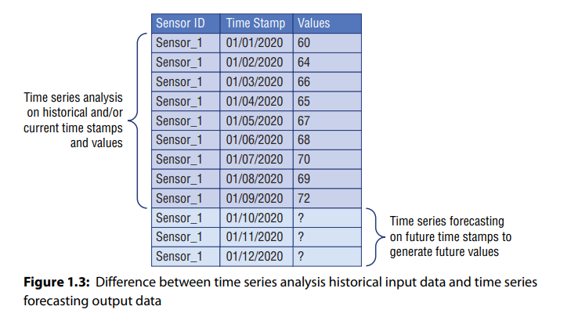
Key Question:
What will customer demand be at some future point in time?
TMT Training
2022

Slide 14
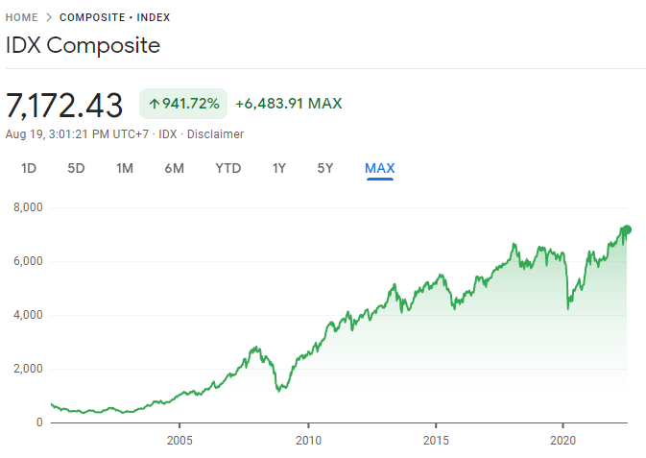
Disclaimer:
Time series analysis from other types of analysis, e.g. regression, classification, clustering, ranking, etc.
But why?
TMT Training
2022

Slide 15
Time-Series Data | Cross-Sectional Data
observations of a single subject varying over time that is not i.i.d | random sample assumed to be i.i.d
TMT Training
2022

Slide 16
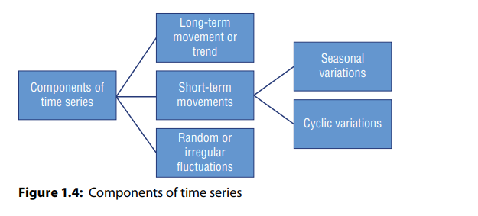
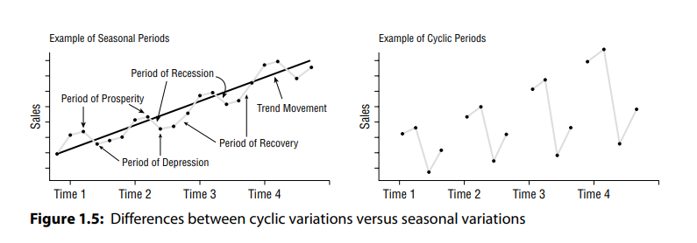
Long-Term Movement (Trend) | Short-Term Movements |  | Random (Noises)
 | Seasonal Variations (Seasonality) | Cyclic Variations
the overall movement of time series values to increase or decrease during a prolonged time interval | periodic temporal fluctuations that show the same variation and usually recur over a period of less than a year | recurrent patterns that exist when data exhibits rises and falls that are not of a fixed period | Sometimes called irregular fluctuations, these are uncontrollable, unpredictable, and erratic due to limitation of our models (our ignorance)
SIGNAL
TMT Training
2022

Slide 17
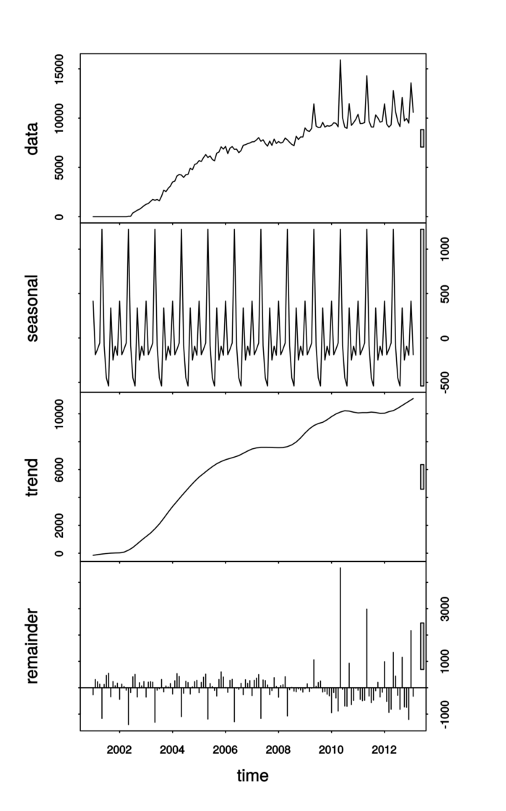
TMT Training
2022

Slide 18
(Boring) things to keep in mind
Inputs and outputs
Granularity level
Horizon
Endogenous and exogenous features
Structured and unstructured features
Univariate and multivariate nature
Single-step or multi-step structure
Contiguous or noncontiguous time series values

Slide 19
Overview of Demand Forecasting Modelling Techniques
TMT Training
2022

Slide 20
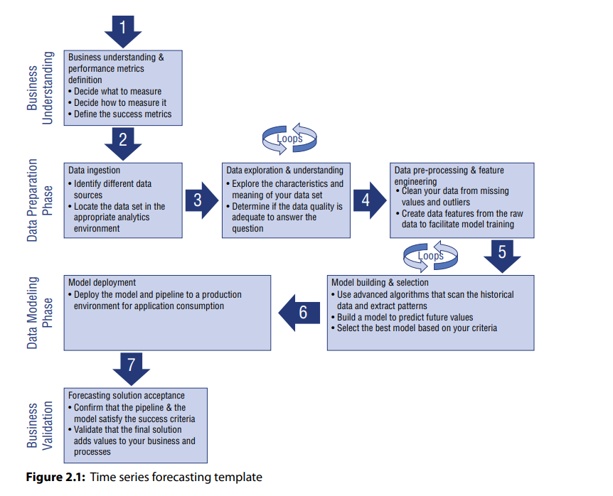

Slide 21
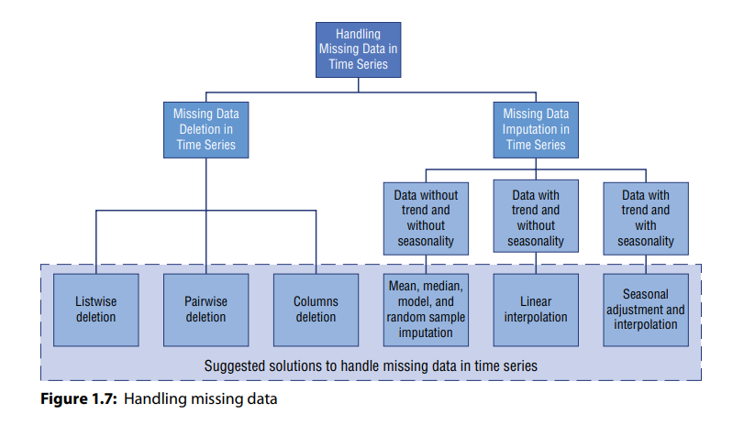

Slide 22
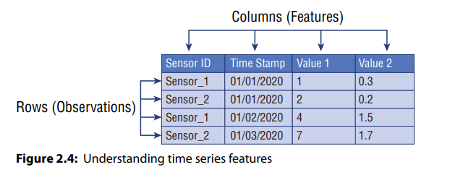
Features Engineering
Time derived Features:
Time of a day
Day of a week
Day of a month
Month of a year
Weekend
Holiday
Fourier time (weighted time)
TMT Training
2022

Slide 23
Any ideas on how we can do the prediction?
TMT Training
2022

Slide 24
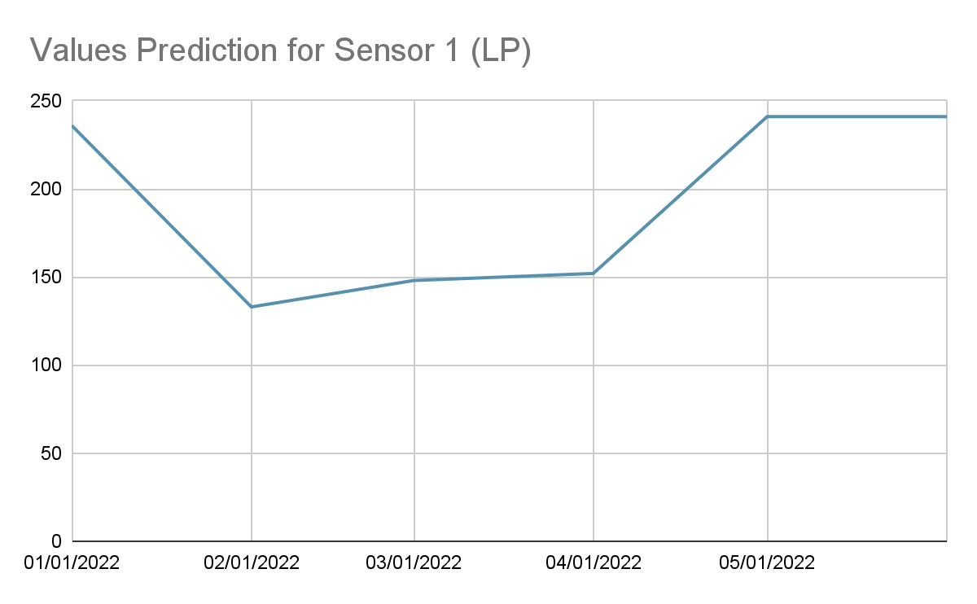

Last Period
Sensor ID | Timestamp | Value
Sensor_1 | 01/01/2020 | 236
Sensor_1 | 02/01/2020 | 133
Sensor_1 | 03/01/2020 | 148
Sensor_1 | 04/01/2020 | 152
Sensor_1 | 05/01/2020 | 241
Sensor_1 | 06/01/2020 | ? (241)
Very naive, I know, but this is still decision based on evidence
TMT Training
2022

Slide 25
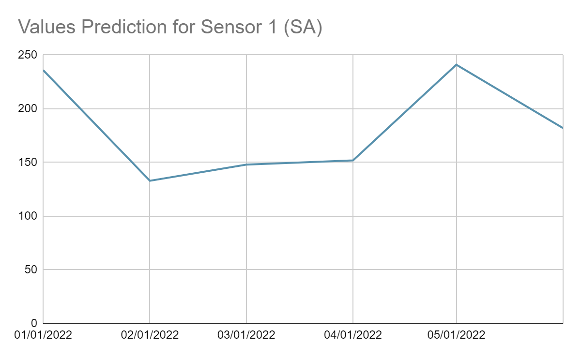
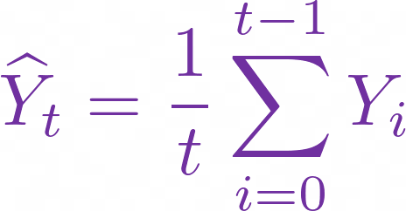
Simple Average
182
Sensor ID | Timestamp | Value
Sensor_1 | 01/01/2020 | 236
Sensor_1 | 02/01/2020 | 133
Sensor_1 | 03/01/2020 | 148
Sensor_1 | 04/01/2020 | 152
Sensor_1 | 05/01/2020 | 241
Sensor_1 | 06/01/2020 | avg(all)
TMT Training
2022

Slide 26
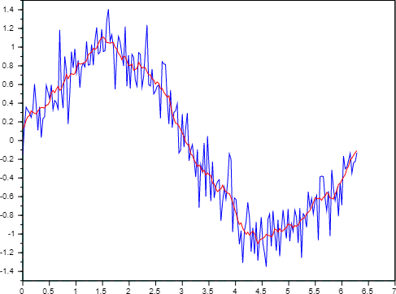
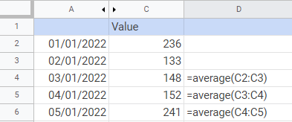
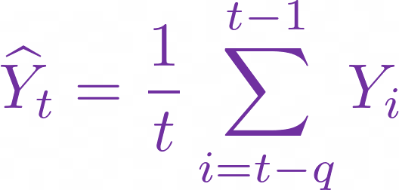
Simple Moving Average
MODEL 2-SMA
TMT Training
2022

Slide 27
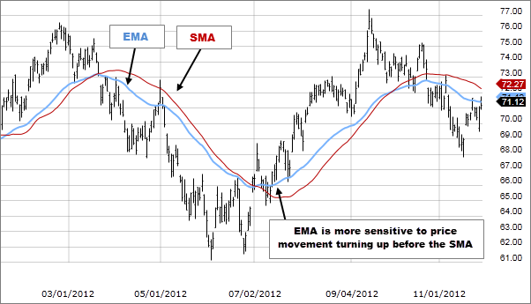
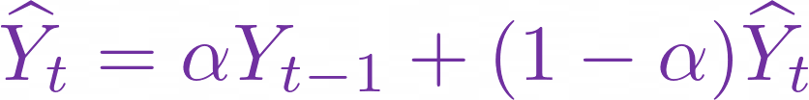
Exponential Moving Average
TMT Training
2022

Slide 28
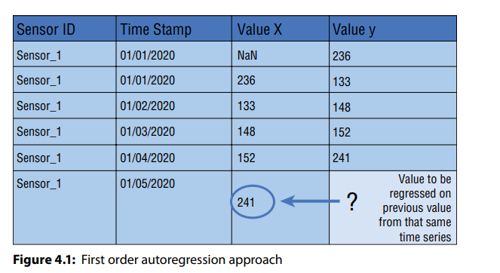
Autoregression
Regression can be used but need to handle with care
TMT Training
2022

Slide 29
Autoregression (p)
Contoh AR(2)
Sensor ID | Timestamp | Value Yt | Value Yt-1 | Value Yt-2
Sensor_1 | 01/01/2020 | 236 | (to fill)
Sensor_1 | 02/01/2020 | 133
Sensor_1 | 03/01/2020 | 148
Sensor_1 | 04/01/2020 | 152
Sensor_1 | 05/01/2020 | 241
Sensor_1 | 06/01/2020 | ?
TMT Training
2022

Slide 30
Moving Average (q)
Misconception Alert!!
Simple Moving Average is done simply by averaging Moving Average model is a regression model
TMT Training
2022

Slide 31
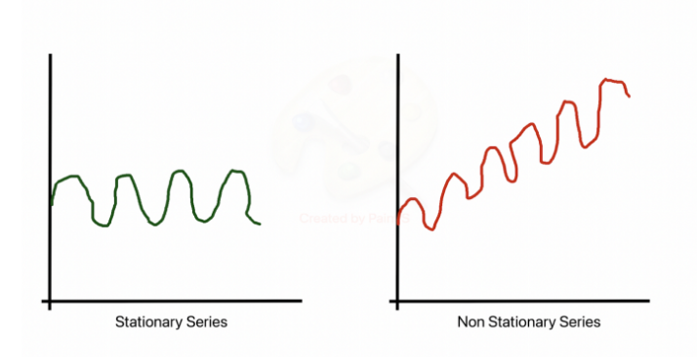
TMT Training
2022

Slide 32
ARIMA (p,d,q)
Autoregressive Integrated Moving Average
AR(p)
MA(q)
differentiate
TMT Training
2022

Slide 33
Model Evaluation
TMT Training
2022

Slide 34
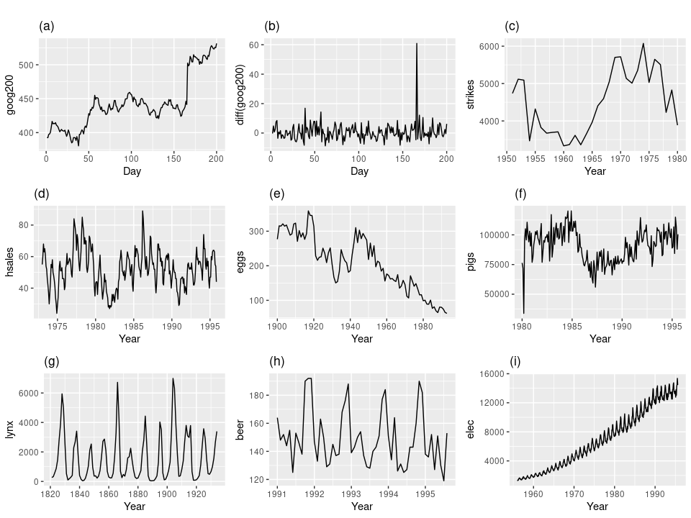
Stationarity
TMT Training
2022

Slide 35
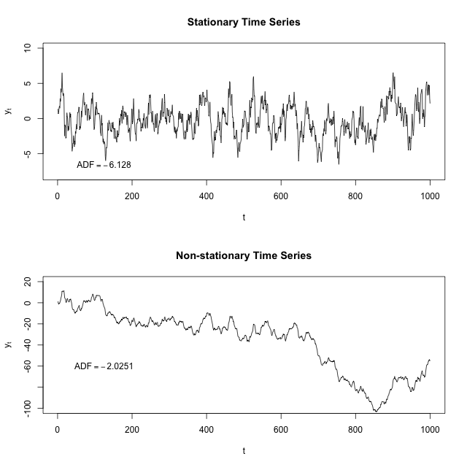
ADF - Stationarity Test
TMT Training
2022

Slide 36
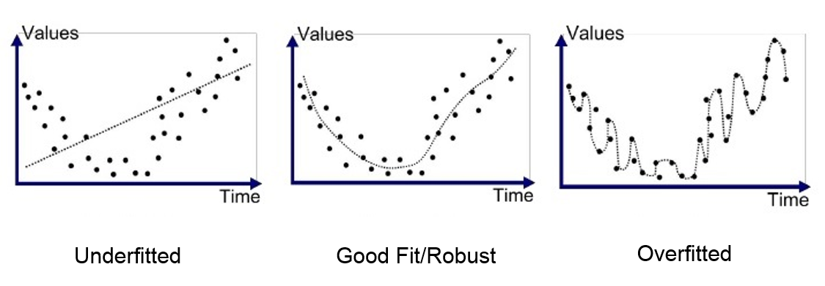
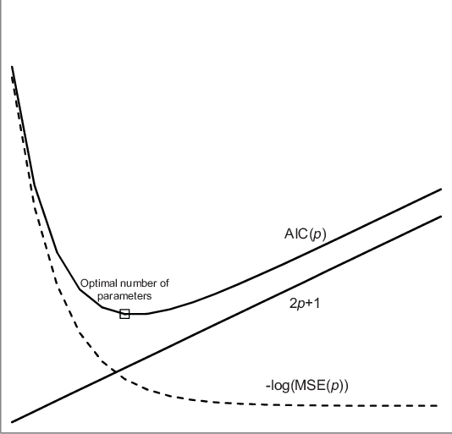
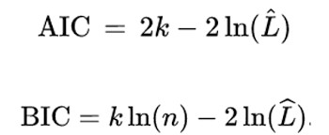
AIC and BIC
TMT Training
2022

Slide 37
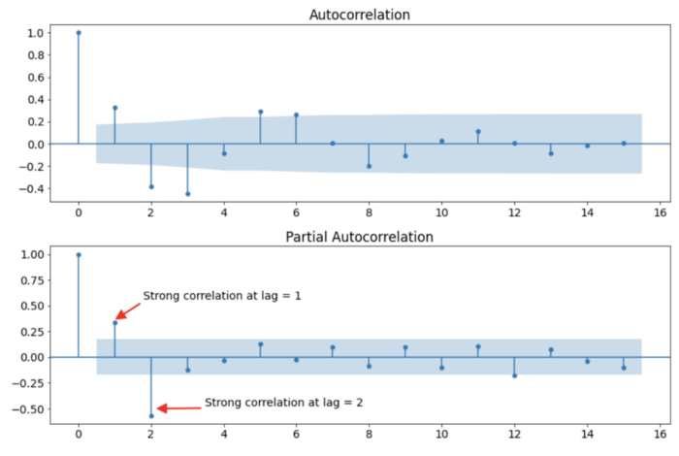



ACF and PACF
ACF is the correlation between a time series with a lagged version of itself.
PACF is the autocorrelation between X_t_t and X_(t-k) that is not accounted for by lags 1 through 𝑘−1.
TMT Training
2022

Slide 38
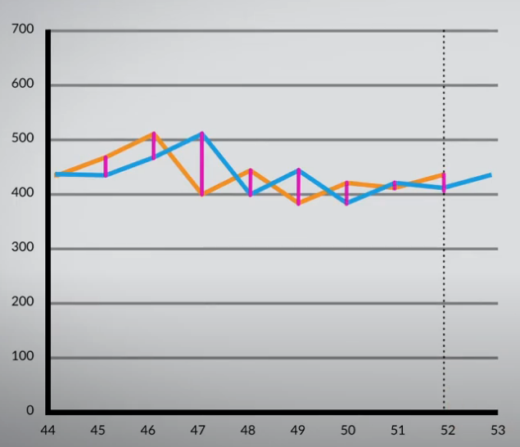
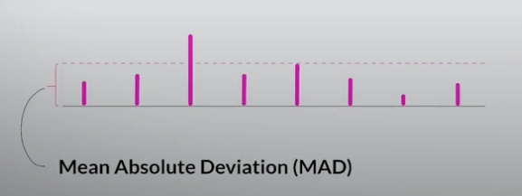
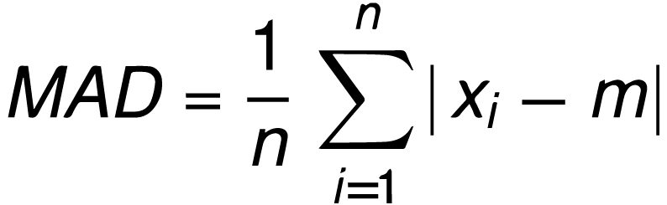
MAD (Mean Absolute Deviation)
TMT Training
2022

Slide 39
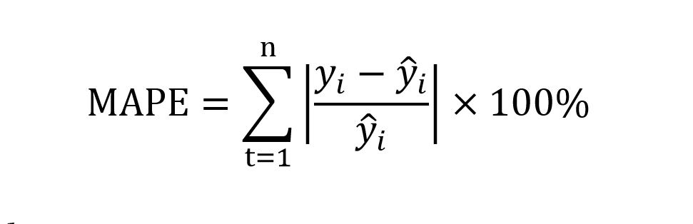
MAPE (Mean Absolute Percentage Error)
TMT Training
2022

Slide 40
Next?
TMT Training
2022

Slide 41
Next
01
Demand Forecasting
02
Smoothing
03
Fine-tuning parameters
04
Panel Data
TMT Training
2022

Slide 42
THANK YOU!
TMT Training
2022

